Slide 1

Welcome to Leadership Environmental Management Awareness & Competency (LEMAC) Training
LEMAC training is for Leaders at All Levels
All Officers & Non-Commissioned Officers and Civilian Leaders (Managers & Supervisors)

Slide 2
Topics Covered in LEMAC Training
Topics
JBLE-Eustis’ Implementation of Environmental Management (EM)
Legal Aspects of Environmental Compliance
Spill and Emergency Response
Hazardous Materials Management
Wastewater and Stormwater Management
Air Quality Management
Pollution Prevention
Solid Waste and Recycling Management
Hazardous Waste Management
Universal Waste Management
Electronic Waste Management
Environmental Management
Environmental Impact Assessments, Natural Resources, and Pesticides
Environmental Restoration Program
Summary of Responsibilities
LEMAC

Slide 3
Part I
This Part Covers:
Environmental Management;
Implementation of Environmental Management; &
Legal Aspects of Environmental Compliance
LEMAC
Leadership Environmental Management Awareness – Slide 4

Slide 4
Leadership Responsibilities
Be the Champion of Environmental Stewardship and Pollution Prevention
Be Knowledgeable with Your Roles, Responsibilities, and the Requirements as specified in JBLE-I 32-101, Environmental Management
Ensure your personnel are familiar with the Installation’s Environmental Policy
Instill Environmental Stewardship through the use of the personnel evaluation system
Integrate environmental sustainable practices into short and long range planning
Ensure your personnel are appropriately trained and supervised
Like Safety, Everyone is responsible for Environmental Stewardship
Note: When You Issue a Command, Directive, Order, Instruction etc.
Do Your Personnel Know the Correct Procedures?
LEMAC

Slide 5
Technical Advisors for Leadership
Your Chain of Command has appointed and trained the following personnel to be technical advisors and representatives (Valuable & Limited Resources):
  Activity Environmental Coordinator (AEC)
    Wing/Brigade or Higher HQs; Squadron/Battalion; Flight
    Directorate and Division levels for Directorates
    Appropriate Corporate levels for Contractors
    Single POC for the Activity on all environmental matters
    Represents the Commander/Director/Senior Leader
  Unit Environmental Coordinators (UEC)
    Company/Detachment or Branch level for Directorates
  Hazardous Waste Coordinator (HWC)
    Manage Activity’s Hazardous Waste Site
    Manage Activity’s Non-Hazardous Waste Sites
Don’t abuse their position by expecting them to do your job.
LEMAC

Slide 6
Keys to Environmental Stewardship
**Command Emphasis**
  Leadership – Top to Bottom; Bottom to top-Starts with You!
  Like Safety, Instill Environmental Stewardship into Your Organization’s Lifestyle
Training of Personnel
  Ensure your Technical Advisors (AECs, UECs, HWCs) are appointed and trained
  Ensure all personnel have received environmental training
  Ensure all personnel are competent in their job skills
Self Inspections & Assessments
  Quarterly Activity Environmental Coordinator Inspections
  Monthly Hazardous Materials Storage Area Inspections Monthly Universal Waste Storage Area Inspections
  Weekly Hazardous Waste Site Inspections
  Incorporate environment into planned and impromptu inspections
Leadership
  Effectively use your Technical Advisor (AECs, UECs, HWCs).
  Ensure SOPs, plans & checklists include environmental considerations
  Ensure Your Functional Area Continuity Books are being updated & used
  Mentor and properly supervise your personnel
LEMAC

Slide 7
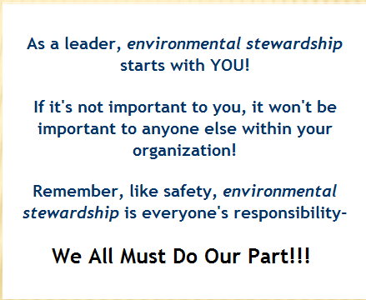
Environmental Stewardship
LEMAC

Slide 8
The ENVIRONMENTAL MANAGEMENT Module
Fort Eustis uses an international standard called ISO 14001 to manage all parts of the environmental program.
It is important for every person working and living on the installation to have an awareness of how ISO 14001 works and embrace “Environmental Stewardship” as a personal responsibility.

Slide 9
Environmental Policy
It all starts with a policy that commits us to do the right thing
As an environmental steward, there are five things that you should practice everyday:
All are responsible for
Comply with all environmental regulations and all requirements while reducing compliance cost and liabilities.
Limit impact we will prevent pollution and minimize waste while cleaning up past sites of environmental concern and making efforts to achieve Chesapeake Bay conservation.
Executive Plans we will identify and attain, environment, safety, and occupational health objectives and targets through planning that is Specific, Measurable, Achievable, Realistic and Timely (SMART).
Achieve improvements: we will continuously improve our programs and processes through the use of effective management and planning.
Notify: we will communicate our environmental commitments and performance to all levels of our organization and local community.
Copies of the policy can be found at:
  https://eustwsintra02.eustis.army.mil/enrd/
  http://www.eustis.army.mil/enrd/portal.asp
  Posted at your work site
Environmental Management (EMS)

Slide 10
How does the ISO 14001 process work?
ISO uses the PLAN, DO, CHECK, ACT method.
Let’s look at a very simple task that soldiers do.
EMS Cycle
4.
1. Commitment & Policy
1.
If drips were found remember to use a pan under the vehicle next time.
Change the oil in a vehicle.
What are the environmental impacts?
(Used oil, possible spills)
Act
Continual Improvement
Plan
5. Review & Improve
2. Planning
4. Measure & Implement
3. Implement
3.
Check
Do
2.
Check under the vehicle.
Clean up any drips.
Change the oil.
Put the used oil in the used oil tank.
Environmental Management (EMS)

Slide 11
Why is all this important?
It provides a thought process to remember environmental
impacts of everyday tasks.
It can help reduce environmental mistakes and save time
and money.
So remember: PLAN DO CHECK ACT
Environmental Management (EMS)

Slide 12
JBLE-EUSTIS’ IMPLEMENTATION OF ENVIRONMENTAL MANAGEMENT (EM)

Slide 13
Primer to JBLE-I 32-101 Environmental Management
One stop document for Environmental Management
Mirrors ISO 14001, Environmental Management System (EMS)
ISO 14001
JBLE-I 32-101
Section 4.2 – Policy
Section 4.3 – Planning (Plan)
Section 4.4 – Operations (D0)
Section 4.5 – Checking (Check)
Section 4.6 – Review (ACT)
Section 4.2 – Policy
Section 4.3 – Planning (Plan)
Section 4.4 – Operations (D0)
Section 4.5 – Checking (Check)
Section 4.6 – Review (ACT)
Specifies the basic Installation policies and requirements
Linked to Environmental Management Procedures (EMPs)
  Specifies the “Who, What, When, Where, and How”
  Not all EMPs apply to all Activities and Operations
  EMPs follow the same numbering system as JBLE-I 32-101

Slide 14
Relationship of JBLE-I 32-101 to EMPs
Hazardous Waste Management (HWM)
JBLE-I 32-101
Section 4.4.6.8 HWM
EMP 4.4.6.8
HWM
Policy
and Require-ments
Policy: Fort Eustis (FE) will efficiently and effectively manage the generation, collection, storage, and disposal of hazardous waste. FE will actively analyze hazardous waste (HW) data and information to identify opportunities and new methodologies to reduce hazardous waste volumes.
Requirements:
Comply with all applicable Federal, State, and local HW, Universal Wastes (UW), and Non-Hazardous Waste (NHW) regulations. Manage these wastes IAW EMP 4.4.6.8, HWM. FE is a Large Quantity Generator (LQG) of HW and operates a Hazardous Waste Accumulation Facility (HWAF). All hazardous wastes (i.e. manifest wastes) must be sent to an approved Treatment, Storage, & Disposal Facility (TSDF) within 90 days of the Accumulation Start Date (ASD) in accordance with EMP 4.4.6.8.1. Activities will minimize the toxicity and quantity of HW, UW, and NHW generation through pollution prevention actions, for example, source reduction, material substitution, and recycling or reuse
EMP 4.4.6.8.3 Container Management
EMP 4.4.6.8.2 Storage & Accumulation Sites
EMP 4.4.6.8.1 HWAF Operations
EMP 4.4.6.8 HW Management
“How To”

Slide 15
Functional Area Continuity Books (FACB)
Functional Areas
Motor Pools
Offices
Classrooms
Arms Rooms
Supply Rooms
Shops, etc.
Library of EMPs
Functional Area – XXXXX
EMP 4.2 30-Sep-09 Environmental Policy
EMP 4.3.1 30-Sep-09 Environmental Aspects
EMP 4.3.2 30-Sep-09 Legal and Other Requirements
EMP 4.3.3.1 30-Sep-09 Objectives and Targets
EMP 4.3.3.1 30-Sep-09 Environmental Mgmt Programs and Action Plans
EMP 4.4.2 1-Jun-10 Environmental Awareness & Competency Training
EMP 4.4.2 Tab 1 15-May-10 Job Titles, Duty Descriptions, and Responsibilities of Key Positions
EMP 4.4.3 30-Sep-09 Environmental Communication
EMP 4.4.4 30-Sep-09 Environmental Documentation
EMP 4.4.5 30-Sep-09 Environmental Document Control
EMP 4.4.6.1 30-Sep-09 Air Pollution Mgmt
EMP 4.4.6.1 Tab 1 30-Sep-09 Air Quality Program Reporting Requirements
Appropriate EMPs for Functional Area
Activity Policies & SOPs
FAC – Files
Procedures for transferring duties:
From one Coordinator or Functional Area
Manager to another
Training of new Coordinators or Functional
Area Managers
Chain of custody for safeguarding Environmental Mgmt records:
(Training, Inspections, Turn-in Documents)
Records Retention Time:
At least 3 years
“How To”
Functional Area

Slide 16
The Legal Aspects of Environmental Compliance Module

Slide 17

Legal Requirements
Legal drivers for compliance efforts, established by Federal, State, or local
laws and tracked Division to ensure we are in compliance
  Human Health & The Environment
    U.S. Environmental Protection Agency (EPA)
    Virginia Department of Environmental Quality (VDEQ)
  Work Place Safety
    Occupational Safety and Health Administration (OSHA)
  Safe Transportation of Hazardous Materials
    U.S. Department of Transportation (DOT)
The Legal Aspects of Environmental Compliance

Slide 18
Environmental Laws & Regulations
Many laws exist having impacts on mission and operations. These laws are designed to protect human health as well as the environment!
Penalties for not following environmental laws and
regulations can be stiff
  Civil Penalties – fines up to $37,500 per incident
  per day
  Criminal Penalties – fines up to $50,000 per day/
incident and imprisonment up to 15 yrs
per incident
Many laws exist, some have more impact on missions and operations.
Clean Air Act (CAA)
Clean Water Act (CWA)
Oil Pollution Act (OPA)
Superfund
Resource Conservation and Recovery Act (RCRA)
Recycling
Tanks
Used Oil
Hazardous Waste
Pollution Prevention
Requirements are articulated in:
Executive Orders
DoD Directives
U.S. Air Force Policies and Instructions
AFPD 32-70
  Environmental Quality
AFI 32-7001
Installation Policies
JBLE-I 32-101
The Legal Aspects of Environmental Compliance

Slide 19
Key Environmental Law Concepts
“Responsible Corporate Officer Doctrine” - means that anyone in the chain of command, including commanders and directors, can be held accountable for the actions of his/her subordinates regardless of whether he had direct supervision or knowledge of the subordinate’s actions.
“Should have known” - by position of leadership or supervision in the organization, the person is responsible for the actions or inactions of his/her subordinates.
“Knowing” – mere knowledge of the facts, but does not have to know that it was illegal or a regulated activity.
“Negligence” - an action or inaction outside your duty which a reasonable person would have not done.
The Legal Aspects of Environmental Compliance

Slide 20
Part II
This Part Covers:
Spills and Emergency Response;
Hazardous Materials Management;
Wastewater and Stormwater Management;
Air Quality;
Pollution Prevention; &
Conservation
LEMAC

Slide 21
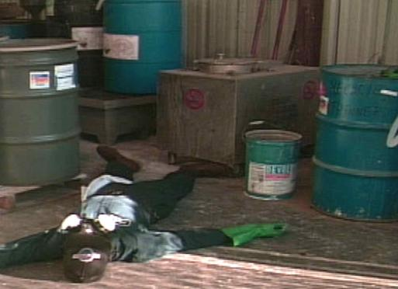
Spills & Emergency Response
The purpose of spill prevention is to minimize hazards to human health or the environment from fires, explosions, or any unplanned sudden or non-sudden release of Hazardous Materials (HM), Hazardous Waste (HW) or HW constituents into the air, soil, ground water, or surface water.

Slide 22
HazWOPER Training Levels
Level 1
* Awareness
Level 2
* Operations
Level 3
* Hazardous Materials Technicians
Level 4
* Hazardous Materials Specialists
Level 5
* Incident Commander
- Witness or discover the release or spill, and report
- Protect nearby persons, property, or the environment from the effects of the release/spill
-Requires additional training
- Stops the release at its source
- Requires additional training
- Supervise and supports the HM Technicians
- Requires additional training
- Assumes control of the incident
Take no further action-understand capabilities and limitations
You are required to have Level 1 Awareness training!
This Module meets Level 1 training requirements.
Spills & Emergency Response
Hazardous Waste Operations & Emergency Response (HazWOPER)

Slide 23
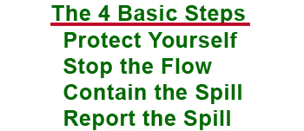
Awareness Level 1 & HazCom Spill Response
First Responders – Awareness Level
  Individuals who are likely to witness or discover release and
  who have been trained to
    Initiate the emergency response sequence
    Take no further action – understand capabilities and limitations
    Assist emergency personnel as requested
HazCom Trained; within your normal work area; have appropriate
personal protective equipment
Spills & Emergency Response
Hazardous Waste Operations & Emergency Response (HazWOPER)

Slide 24
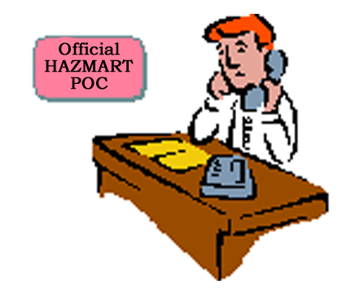
Spill Response
First
Responder
Trained
Fire or explosion involving HM, HW, UW or NHW
Accidental or intentional spill (any quantity) that
reaches the ground, drain, or water
Release to the air of highly volatile products, which
could threaten human health or the environment
Call 911 and notify your supervisor (if using a cell phone, call 878-1008)
ALWAYS
Report the spill regardless of size???
Call
Emergencies: 911
Non-emergencies: 878-1008
Spills & Emergency Response
Hazardous Waste Operations & Emergency Response (HazWOPER)

Slide 25
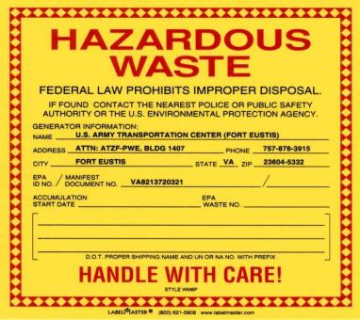
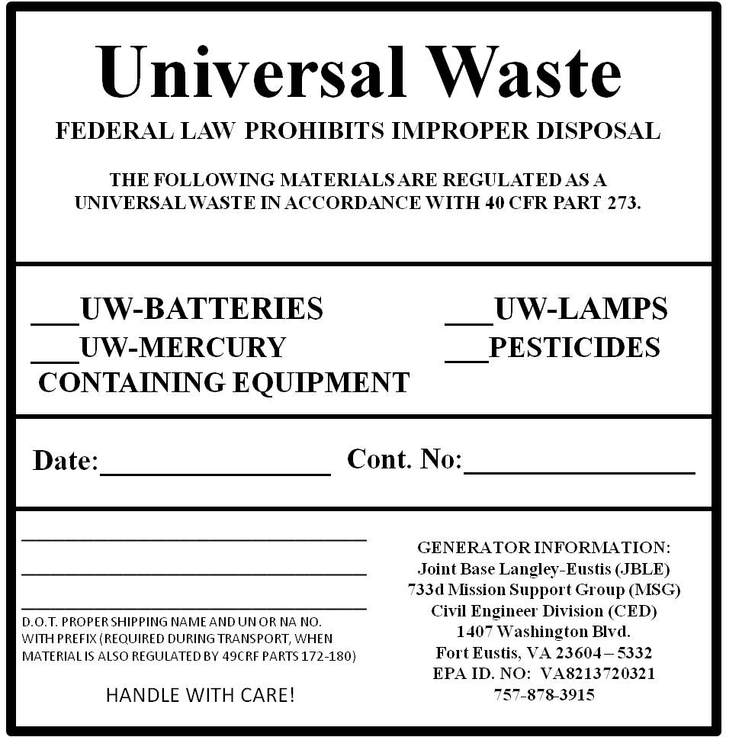
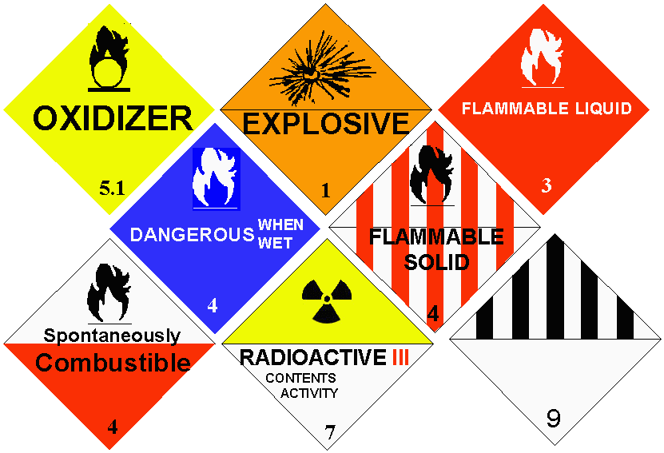
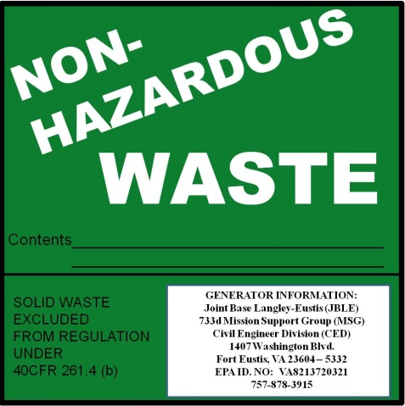
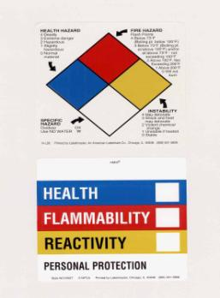
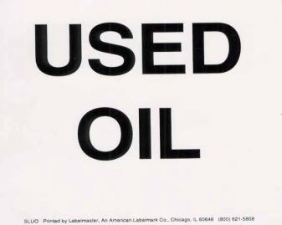
Determine the Identity (Know Your Warning Labels)
Spills & Emergency Response
Hazardous Waste Operations & Emergency Response (HazWOPER)

Slide 26
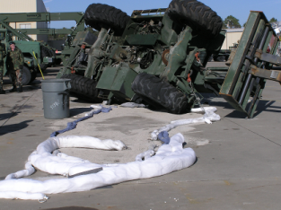
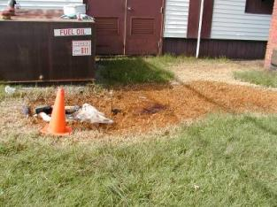
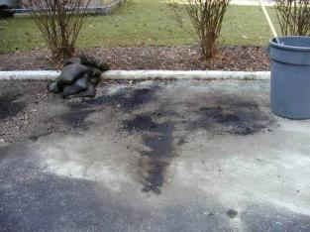
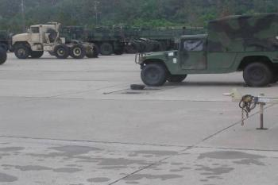
What is a Spill?
Leakage, seepage, or other release
The unintentional or intentional spilling, leaking, pumping, pouring,
emitting, emptying, or dumping of hazardous waste, material or
petroleum product into or on any land, water or air
ALWAYS
Report the spill regardless of size???
Call
Emergencies: 911
Non-emergencies: 878-1008
Spills & Emergency Response
Hazardous Waste Operations & Emergency Response (HazWOPER)

Slide 27

How Do Spills Occur?
Refueling Operations
Vehicle/Vessel Maintenance
Storage/Handling
Transporting/Relocating Materials & Wastes in Open or
Unsecured Containers
Auto accidents
Equipment Malfunctions/Breakage
Poor housekeeping practices
Human error-most frequent cause!!!
Spills & Emergency Response
Hazardous Waste Operations & Emergency Response (HazWOPER)

Slide 28
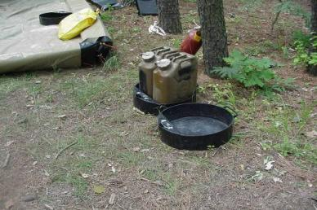
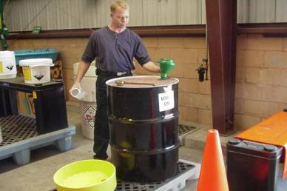
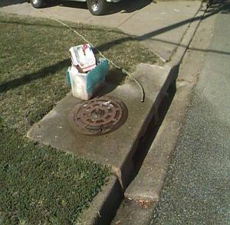
What can I do to prevent spills?
Provide secondary containment
Use funnels when filling containers
Keep clear of water sources/drains
Use drip pans
Use proper materials
Follow proper procedures
Take Your Time!
Spills & Emergency Response
Hazardous Waste Operations & Emergency Response (HazWOPER)

Slide 29
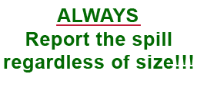
What is an Emergency Situation?
Fire or explosion involving HM, HW, UW or NHW
Accidental or intentional spill (any quantity) that
reaches the ground, drain, or water
Release to the air of highly volatile products,
which could threaten human health or the
environment
Call 911 and notify your supervisor (if using a
cell phone, call 878-1008)
Spills & Emergency Response
Hazardous Waste Operations & Emergency Response (HazWOPER)

Slide 30
What is a Non-Emergency Situation?
Spills that can be absorbed or controlled by activity or maintenance
personnel in the immediate area or, and:
  Spill contained on hardstand, within building, or structure.
  If there is no release to the ground or drains or into a body of
  water
  A small spill contained within a containment device is not
  considered an emergency spill
Call 911 and notify your supervisor (if using a cell phone, call 878-1008)
Spills & Emergency Response
Hazardous Waste Operations & Emergency Response (HazWOPER)

Slide 31
Hazardous Materials Management

Slide 32
Hazardous Materials Management
Hazardous Materials (HMs) – any
serviceable material or product, which
has a chemical, physical, or health hazard
  As defined by DOT
  As defined by OSHA
The HazMart – Your One-Stop Shop for Purchases & Approvals of HazMat?
  All HMs must be approved and added to your AUL by the HazMart
  (Bldg 1205)
DO NOT use credit cards, except Local Purchased approved by the HazMart
DO NOT purchase HMs outside of the post with your
money and bring to work!!
DO NOT use your POV to transport HMs
Containers must be properly labeled
Containers must be CLOSED when not in use

Slide 33

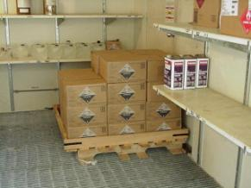
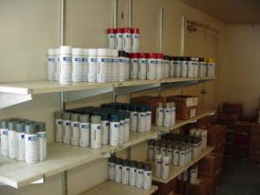
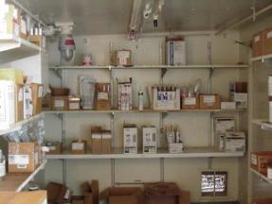
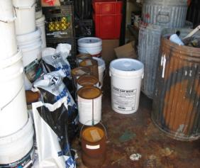
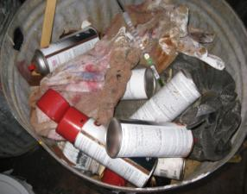
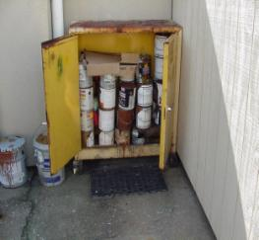
Hazardous Materials Management
The Correct Way to Store Hazardous Materials
The Incorrect Way to Store Hazardous Materials

Slide 34
Wastewater & Stormwater Management

Slide 35

What is Storm Water ?
Water that falls from the sky is clean storm water
Polluted storm water does not fall from the sky
  Hazardous material spills
  Leaks & drips from vehicles, pipes, etc.
  Water from garden hoses
  Water from washing vehicles and other equipment in non-
  approved washing areas
What is Wastewater?
Domestic sewage
Water from industrial operations
  Discharges from
    motor pools
    washing facilities
    industrial sinks
    oil water separators
Wastewater & StormWater Management

Slide 36

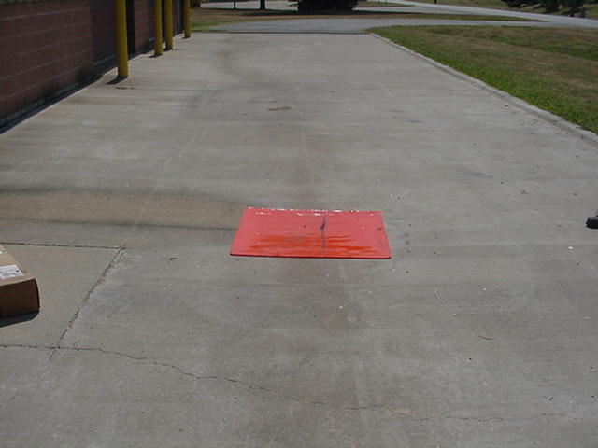
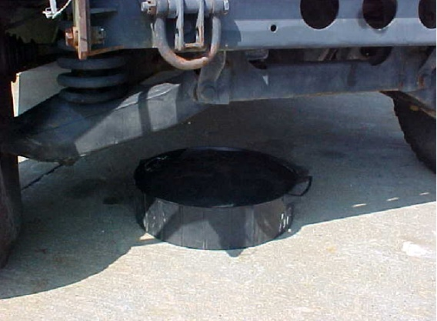
Good housekeeping practices
Prevent Spills
Use drain covers
Maintain drip pans for tactical vehicles
Wash vehicle/equipment at approved washing facilities
Appropriate storage of hazardous materials and waste in accumulation
areas
Appropriate use of containment systems
  Must hold 110% of largest container
Be aware of where your spill kit is maintained
Keep containers closed
Only rain water can be discharged to the stormwater system
  BPAs prevention other discharges
  All other discharges must be approved
Other than sewage, other wastewater discharges must be approved
Wastewater & StormWater Management

Slide 37


Used to separate a small amount (less than 5%) of oil from a larger volume
of water
Degreasers prohibited
Don’t use as a dumping spot
  Used oil should be properly disposed
Only approved wash racks will be used for military vehicle and equipment
cleaning
Generally, wash racks are connected to oil water separators
  Degreasers prohibited
  Don’t use as a dumping spot
DO NOT wash equipment using garden hoses (ex: lawn mowers, weed eaters)
No POV maintenance in Family housing or at barracks – Only at Auto Craft Shop
Family Housing (ONLY EXCEPTION)
  Residents can wash their POVs in family housing with mild detergents only
Wastewater & Storm Water Management

Slide 38
Air Quality

Slide 39
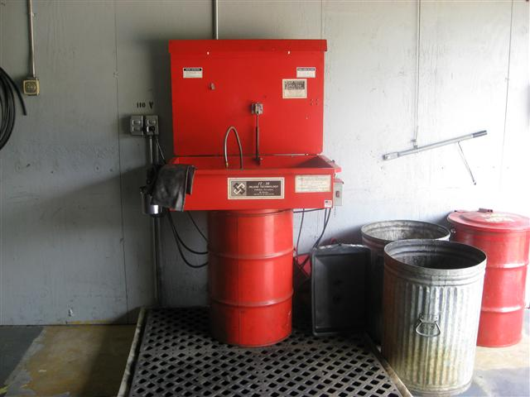
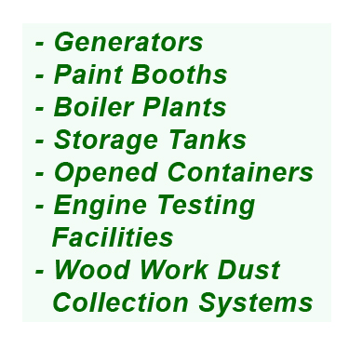
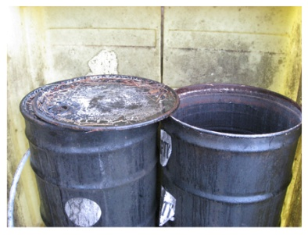
Air Quality
The JBLE air permits regulate the amount of emissions
being emitted from stationary sources
!
!
Remember to keep all containers closed.
Individuals operating this type of equipment, must have specific training
and certain certifications, which follow the established SOPs
Air Quality

Slide 40
Pollution Prevention

Slide 41
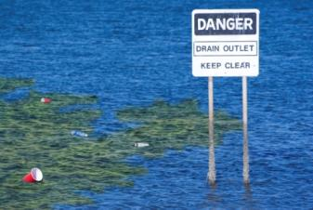

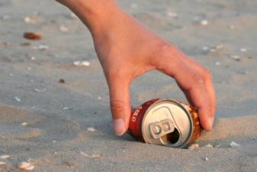

What is Pollution Prevention (P2) and What Can I Do?
Pollution – the discharge of waste materials into the air, water, or land
  Examples: car exhaust, oily water from motor pools, household and
  office garbage
Methods to reduce or prevent pollution
  Reduce (best choice) – ex: carpool, use less plastics and paper that
  require disposal
  Reuse – ex: wash oily rags, clean and reuse antifreeze
  Recycle – ex: cans, plastics bottles, metals, CD/DVDs, paper, cardboard
  Recover/disposal – ex: waste-to-energy plant, composting
Pollution Prevention

Slide 42

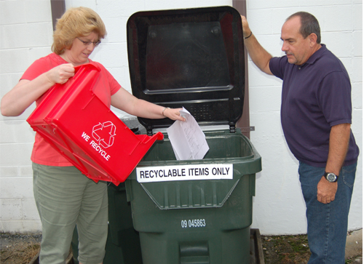

Implementation
Be a champion for P2
Recycle, Recycle, Recycle – think before you toss
anything into the trash bin
Buy “green” items made from recycled materials
Buy “green” items that can be recycled
Be careful with hazardous materials and wastes
Pollution Prevention

Slide 43
Green Procurement
What is: “Green Procurement”
Products That:
-Have recycled content
-Are made with renewable materials (not oil)
-Are energy efficient
-Use alternative energy (GSA vehicles)
-Contain the fewest toxic chemicals (cleaners/solvents)
Who Must Buy Green?
-Government purchase card users
-Facility managers (furniture, carpet, & equipment)
-Leaders/managers approving larger purchases (copiers, office equipment, services)
What “Green” Products are Available?
-Construction
-Landscaping
-Non-paper office products
-Parks and recreation
-Transportation
-Vehicular
-Miscellaneous
Benefits of Recycled Products
-Creates recycling markets
-Saves energy
-Conserves resources
-Saves money
-Saves landfill space
-Reduces pollution
-Promotes new technologies
-Promotes environmental stewardship
EPA Environmentally Preferable Purchasing Database: www.epa.gov/oppt/epp
Pollution Prevention

Slide 44


Implementation
Conservation of Water and Energy
Water and energy are limited resources
Expensive
Producing water and energy is hard on the environment
JBLE-Eustis has an active conservation program
Water Tips
Short showers
Turnoff while brushing teeth, shaving
Energy Use
Turnoff lights/monitor
Close windows
Adjust thermostat
For more tips go to Conservation Tips: http://www.eustis.army.mil/enrd/Green%20Perspectives.htm
Pollution Prevention

Slide 45
Part III
This Part Covers:
Solid Waste and Recycling;
Hazardous Waste Management (HWM);
Universal Waste Management (UWM);
Electronic Waste;
Natural Resources, cultural Resources and Pesticides;
Environmental Restoration; &
Summary of Responsibilities
LEMAC
Leadership Environmental Management Awareness – Slide 4

Slide 46
Solid Waste & Recycling

Slide 47
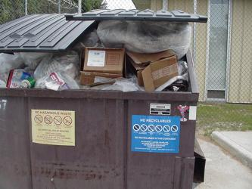
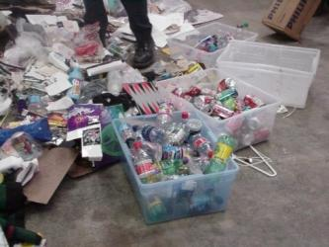
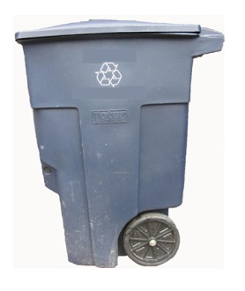
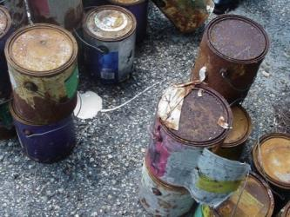
Solid Waste (SW) – What is it?
SW is anything that we discard (throwaway) or abandoned, however, not all
SW can go into the dumpsters.
Solid Waste Examples
Solid Waste & recycling Management

Slide 48
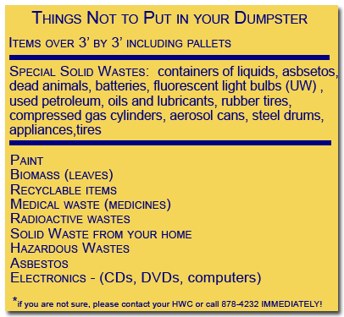

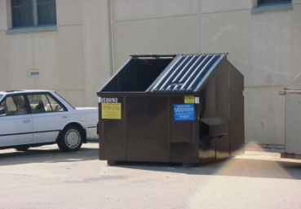
Disposal
Can it be disposed of in a dumpster
Can it be recycled
Is it something that meets special solid waste definition (see graphic below)
!
!
WET TRASH CAN BE HEAVY! WHEN WE DISPOSE OF WASTE WE PAY BY THE TON…PLEASE KEEP THE LIDS ON THE DUMPSTERS CLOSED!!!
Solid Waste & recycling Management

Slide 49
Sites
Office and classroom areas should have a recycling area.
  Examples of recyclables: aluminum cans; plastics,
  e-materials…
Motor Pools
  Examples of recyclables: aerosol cans, lead acid batteries
  (vehicle types); scrap metal…
Card Board containers – these containers are for cardboard only!
Dumpsters – Examples: trash, garbage, rubbish
Before Recycling, know Hazardous Materials & the types of wastes
Fort Eustis has converted to a single stream recycling system throughout its
offices
  All recyclables can be placed into one container
    Paper (all office paper), plastics bottles(#s1&2 only), aluminum, and glass
!
For more information on recyclables, contact either your AEC, UEC, HWC, or RC.
!
Solid Waste & recycling Management

Slide 50

Do NOT Place the Following in the Toters:
Prohibited Items
Trash, Garbage, Refuse
Wood Products
E-Wastes (CDs/DVDs, Magnetic Media, etc.)
Fluorescent or Projector bulbs
Plastic bags
Yard Waste
Shredded Paper*
Diapers
Batteries
Cardboard Boxes
Shredded paper (DO NOT shred CDs or DVDs with paper) – Pickups will be on Tuesday. Activities must schedule with the SWRPPC NLT 1200 hrs on Monday (878-2692 or 878-4232)
Household wastes from on Base or off Base Cannot be placed in Totes or Base Dumpsters
Solid Waste & recycling Management

Slide 51
Hazardous Waste Management

Slide 52

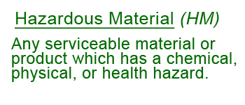
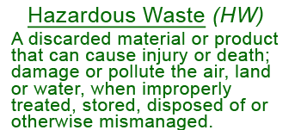
Hazardous Waste Management
What’s the Difference?
Did you know that : NHW is any waste generated from serviceable HMs, which do not meet the definition of HWs
Here are some common hazardous wastes examples and sources: acids or
bases/caustics, cleaners, fluorescent bulbs, contaminated antifreeze, flammable
solvents, oil-based paint, photo finishing solutions, two parts, improperly managed
HMs ex. Expired shelf-life, unused “left over” HMs (ex. Excess) , mixing HW with a
Non-HW (ex. oil based paint w/latex paint, improper storage (ex. paints that freeze),
expired shelf-life, abandoned containers, unknown contents or lack of labels.
Prior to disposing of HM, coordinate with your Activity Environment Coordinator (AEC)

Slide 53
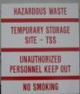
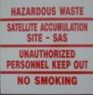
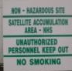
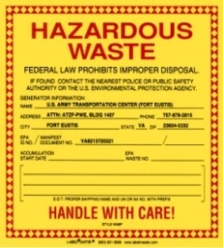
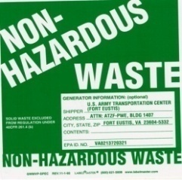
Hazardous Waste Management
Different Waste Sites
Hazardous Waste (HW) Sites
  TSS – Temporary Storage Site
  SAS – Satellite Accumulation Site
    Common HWs - oil based paints; solvents;
    acids; bases; strong cleaners; solvent rags; solvent & gasoline
    filters; etc
Non-Hazardous Waste (NHW) Sites
    Common NHW – used petroleum rags; latex paints; used oil
    and air filters (No solvent or gasoline filters); batteries
    (alkaline), etc.
Universal Waste (UW) Sites
    Common UW – fluorescent light bulbs, projector bulbs,
    batteries
DO NOT DISPOSE OF HW, NHW, or UW IN DUMPSTERS

Slide 54
Hazardous Waste Management
Disposal
Containers: HazMat, Wastes, Dumpster, etc.
All Containers:
  Must be properly labeled
  Must be closed except to add or remove materials
  Must be in good condition
  Containers not meeting these requirements may be considered HW
Hazardous Waste (HW) Containers
  TSS – Temporary Storage Site – dated when HW first added
  SAS – Satellite Accumulation Site
    Dated when ready for turn-in
    Dated when quantity limits are met (usually 55 gallons)
Non-Hazardous Waste (NHW) Containers – don’t have to be dated
Universal Waste (UW) Containers
  Dated when HW first added
DO NOT DISPOSE OF HW, NHW, OR UW IN DUMPSTERS

Slide 55
Universal Waste Management

Slide 56
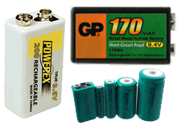

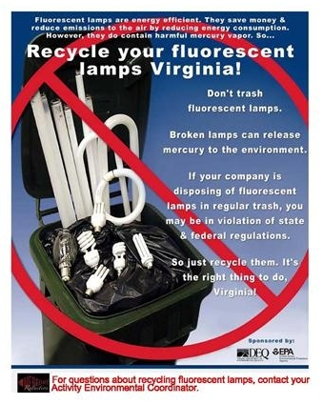
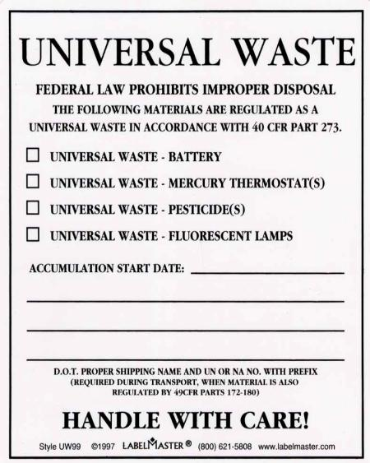
Universal Waste Management
What is Universal Waste (UW)?
It’s a limited number of wastes that would otherwise have
to be managed as HWs, e.g., batteries, lamps, pesticides,
mercury-containing equipment, such as thermostats
It does not need to be approved
Can not be disposed of in dumpsters
Universal Wastes Containers
Should be correctly labeled
Should be dated
Should be closed
Batteries separated by type
Battery Terminals Protected (Taped)
UW Label

Slide 57
electronic waste

Slide 58


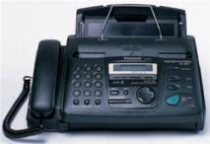


Electronic Waste (e-Waste)
Electronic Waste (e-Waste) is a general term for discarded
electronic products & related materials
Electronic products contain Integrated Circuits or
semiconductor Materials
  Examples of e-Waste: components and devices, electronic data
  processing equipment, office, office equipment, consumer
  electronics, telecommunication, communication and radar, control
  and instrumentation, medical and industrial instrumentation,
  automotive electronics

Slide 59

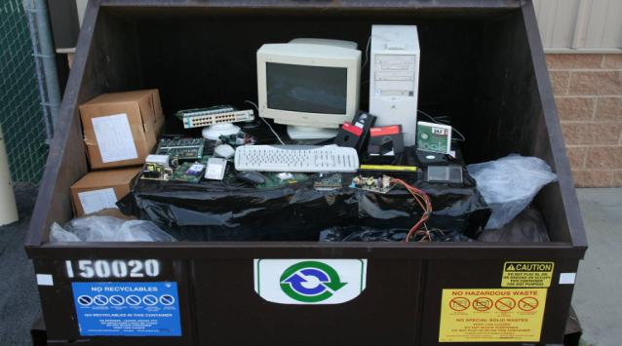




Electronic Waste (e-Waste)
e-Waste is hazardous and contains hazardous substances such as lead, mercury,
chromium, cadmium, and beryllium
e-Waste contains valuable metals such as aluminum and copper and precious
metals – gold, silver, platinum and palladium
All e-waste should be disposed of at the recycling center (note: please be aware
that you should see your AEC before taking equipment to the recycling center)
Unacceptable Methods for Disposing of e-Waste!
Contact Your :
Activity Environmental Coordinator (AEC) or
Hazardous Waste Coordinator (HWC) or
Recycling Coordinator (RC)
for Proper Disposition of E-Wastes & E - Materials

Slide 60
Natural Resources, Cultural Resources, & Pesticides
Natural Resources, Cultural Resources, & Pesticides Management

Slide 61



Natural Resources
Wildlife (wild, undomesticated animals) living in natural areas
    Ex: white-tail deer, waterfowl, reptiles, amphibians
JBLE- Eustis is home to an abundant wildlife and we are required to protect it
If you come across dead wild life, you should contact the Environmental Element office
Wetlands – Special, important habitats that interface between uplands (non-wetlands) and water areas
Trees and forestry products – All trees need to be properly managed.
  Firewood and mulch are examples of forestry products
The Natural Resources, Cultural Resources, & Pesticides

Slide 62


Cultural & Historic Resources
Sites, structures, landscapes, and objects of some importance to a community or
culture for scientific, traditional, religious, or other reasons
Installation has 229 Archaeological Sites
  Native American, Colonial, and Civil War
No unauthorized digging
Metal detectors are illegal on all Army installations
What are your responsibilities?
If you find an artifact, it is the property of the US
Government. Contact the Cultural
Resources office, 878-7365
Do not pick the item up, leave it
where you find it
The Natural Resources, Cultural Resources, & Pesticides

Slide 63



Pesticides
Pesticides are products with chemical substances used to kill or remove pests (pests
are insects or other invertebrates & certain wildlife identified by natural resources
staff as being a nuisance, health risk, or structurally damaging).
When pesticides are incorrectly used, people and wildlife can be harmed, and habitats
severely damaged (these substances can trigger serious health effects if exposed to
them).
!
Remember, only authorized and certified applicators are allowed to use pesticides here on JBLE-Eustis.
!
The Natural Resources, Cultural Resources, & Pesticides

Slide 64
Environmental Restoration

Slide 65
Environmental Cleanup
The Air Force Environmental Restoration Program Includes:
Installation Restoration Program (IRP)
  Identifies, investigates and cleans up contamination from releases which occurred prior to 1 Jan 84
Compliance-related Cleanup (CR) Program
  Identifies, investigates and cleans up contamination resulting from operations that have
  occurred since Jan 84
Military Munitions Response Program (MMRP)
  Includes munitions responses to address unexploded ordnance (UxO), discarded military
  munitions (DMM) and/or munitions constituents (MC) at sites other than on operational
  ranges, and
Where release occurred prior to 20 Sep 02

Slide 66

Environmental Cleanup
Joint Base Langley-Eustis (Fort Eustis) was listed on the National Priorities List in December 1994
The Restoration Programs follows these regulations and instructions:
  Comprehensive Environmental Response, Compensation and Liability Act (CERCLA), as amended by the Superfund Amendments and Reauthorization Act of 1986 *SARA)
  National Oil and Hazardous Substances Pollution Contingency Plan (NCP)
  Resource Conservation and Recovery Act (RCRA)
  Air Force Instruction 32-7020

Slide 67




Environmental Cleanup
JBLE-Eustis has areas that have been contaminated through past military activities. They are currently being or have been cleaned-up.
Areas that have use restrictions
  Eustis Lake
    Open for fishing on a “catch and release” basis only, No swimming
  Brown’s Lake
    Fishing is not allowed at this lake and there is no swimming
Eustis Lake
Brown’s Lake

Slide 68
Summary of Responsibilities

Slide 69
Summary of Responsibilities
Overall Procedure
Plan
Ensure all Activity personnel receive environmental training
Implement
Incorporate environment into planned and impromptu inspections
Continue to improve
Adhere to the Environmental Consideration process (NEPA)
Incorporate ‘green’ into procurement (credit card purchases, contracts, etc…)
Know and live the Environmental Policy

Slide 70
Summary of Responsibilities
Responsibilities
Champion environmental stewardship
Operate IAW JBLE-I 32-101, Environmental Management
Set environmental goals for your Activity
  100% of Leaders are using the personnel evaluation system to instill environmental stewardship in subordinates
  100% of Activity personnel receive environmental training
  100% of Activity facilities have assigned Building Recycling & Energy Monitors (BREMs)
  Energy and Water conservation, maximize Recycling and Waste reduction, etc.
Appoint and train environmental technical advisors
  Activity Environmental Coordinators (AECs)
    Single Point of Contact for the Activity on all environmental matters
    Represents and speaks for the Commander/Director/Senior Leader in their absence
  Unit Environmental Coordinators (UECs)
  Hazardous Waste Coordinators (HWCs)

Slide 71

Summary of Responsibilities
Responsibilities Continued
Commanders or Deputy/Executive Officer Quarterly ESOH Council
  Wing, Brigade or Higher On-Base HQs
  Battalion, Squadron, or Division
Incorporate environment into planned and impromptu inspections
Adhere to the National Environmental Policy Act (NEPA)
Incorporate “green” into procurement (credit card purchases, contracts, etc...)
Establish Continuity Books for Functional Areas (motor pools, supply rooms, arms rooms, shops, etc.)
  Procedures for transferring duties from one Coordinator to another
  Chain of custody for safeguarding Environmental Management (EM) records
  Training, inspections, turn-in documents, etc.
  All current EMPs which apply to function area
Know and live the Environmental Policy

Slide 72
Summary of Responsibilities
The Environmental Policy and Mission
Comply we will comply with all environmental regulations and all requirements while reducing compliance cost and liabilities
Limit Impact we will prevent pollution and minimize waste while cleaning up past sites of environmental concern and making efforts to achieve Chesapeake Bay conservation
Execute plans we will indentify and attain energy, environment, safety and occupational health objectives and targets through planning that is Specific, Measurable, Achievable, Realistic and Timely (SMART)
Achieve improvements we will continuously improve our programs and processes through the use of effective management and planning
Notify we will communicate our environmental commitments and performance to all levels of our organization and local community

